Slide 1
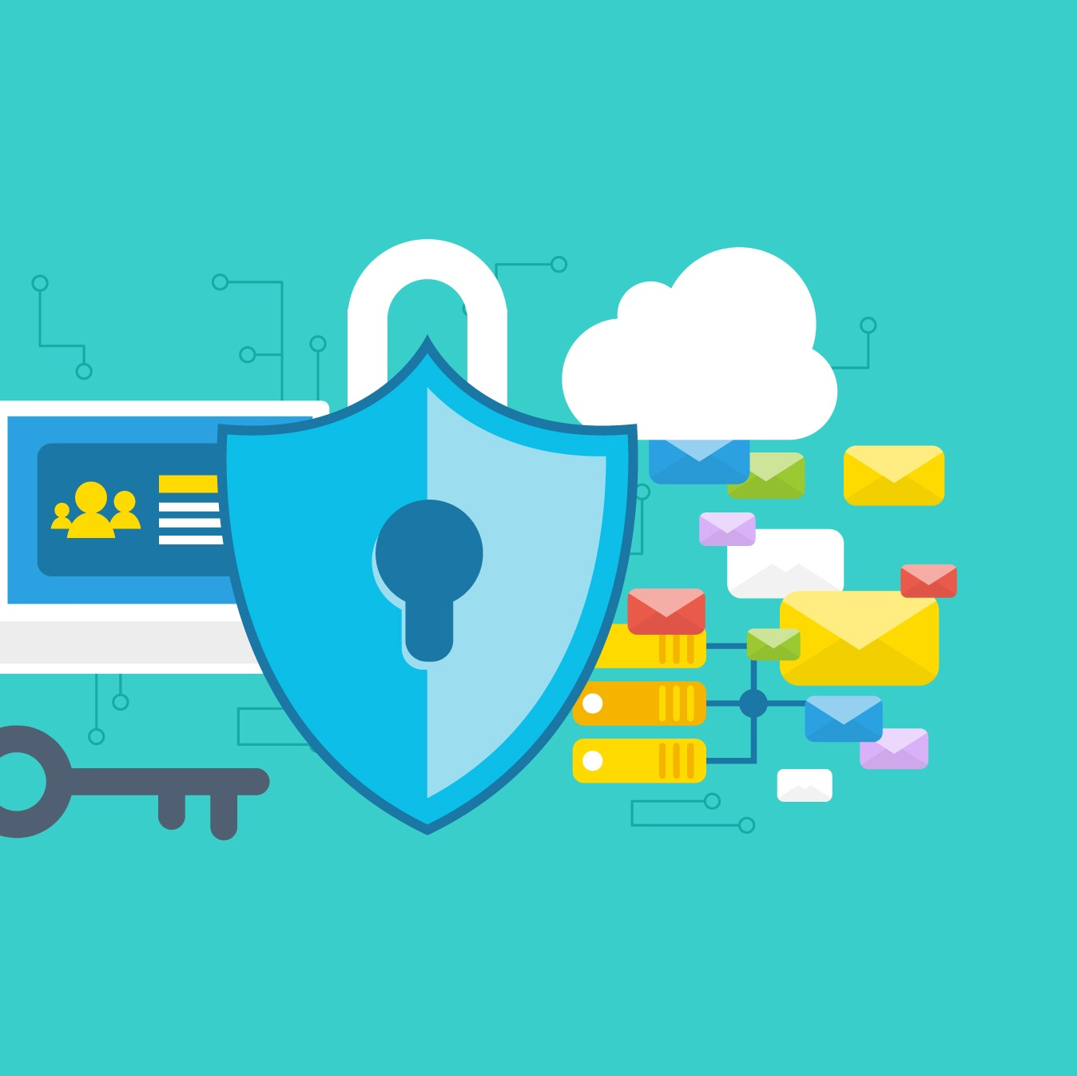
Security for Web APIs
HTTPS
HTTP over TLS
This Photo by Unknown Author is licensed under CC BY-SA-NC

Slide 2
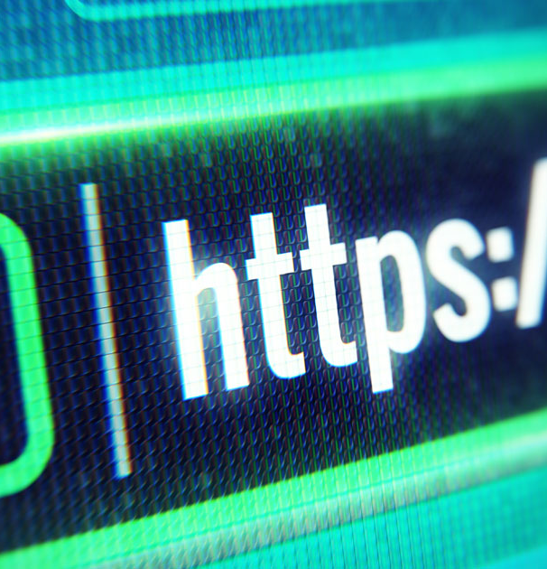

Web Security
Anything you do on Web usually involves sending/receiving messages from a server, often with HTTP
How do you know messages have not been changed/viewed in transit?
Man in the Middle attack
Improvement:
Encrypt/Decrypt message using a shared Key
But how do you share the key is you’ve never met. That could be intercepted if sent (MITM attack again)
Encrypt/Decrypt using public/private key. But do you trust the person your communicating with is the person you think they are (Trust)
Public Certificate Authority. Trusted Authority can digitally “sign” certificates that contain public key.
HTTPS explained with Pigeons: https://www.freecodecamp.org/news/https-explained-with-carrier-pigeons-7029d2193351/
This Photo by Unknown Author is licensed under CC BY-SA

Slide 3
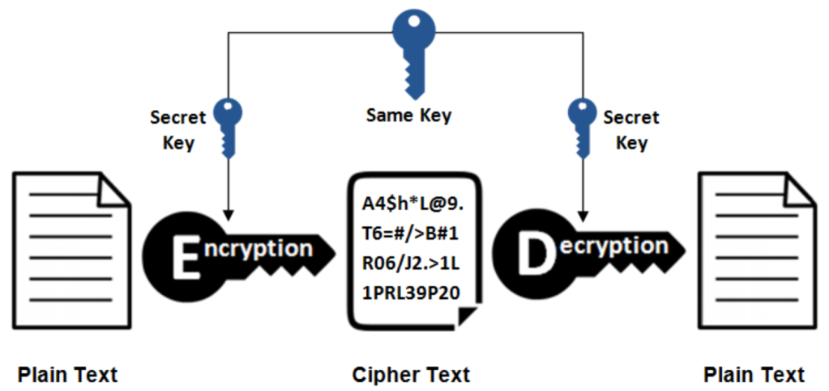
Symmetric Encryption
How do you share keys…
Key Distribution a problem
This Photo by Unknown Author is licensed under CC BY

Slide 4
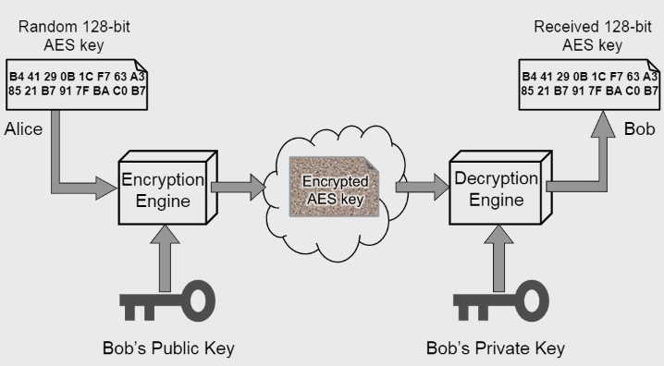
Public Key Crypto
Sender and Receiver have different keys
Susceptible to Man in the Middle Attacks.
How do you trust the public key is the correct one. Is it issued to you by the real owner???

Slide 5
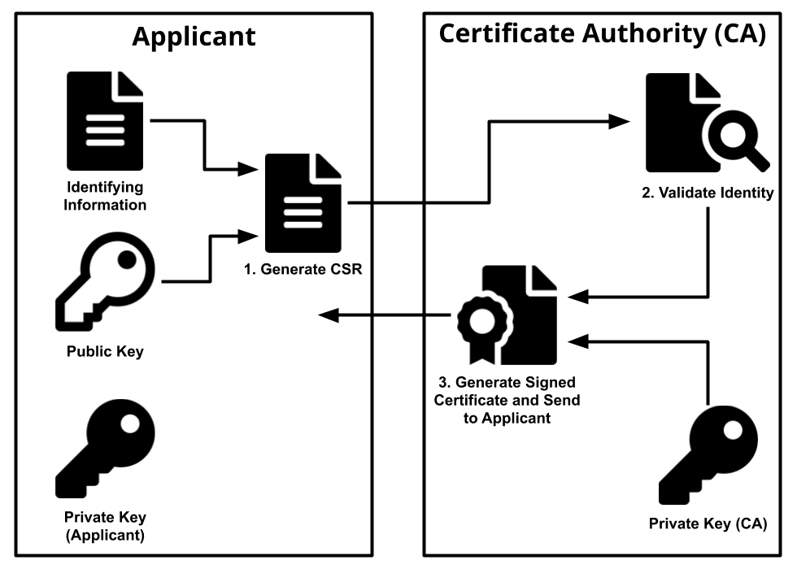
Certificates
How do you know if a Public Key is genuine?
A key could be signed by someone who’s public key you have AND you know it’s correct AND you trust them!
A digital cert is an electronic document
Signed by a third party Certificate Authority
Cert user trust the CA to issue valid certs
Digital Cert contains:
The owner
The Public Key
Issuer (Cert Authority)
Issuers digital signature
Valid Period

Slide 6
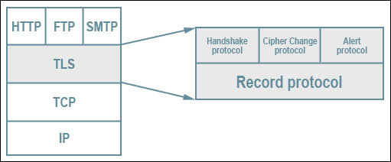
Securing Web APIs
HTTP provides no security
The accepted approach is to add security on top of Transport Layer
This is Transport Layer Security (TLS)

Slide 7
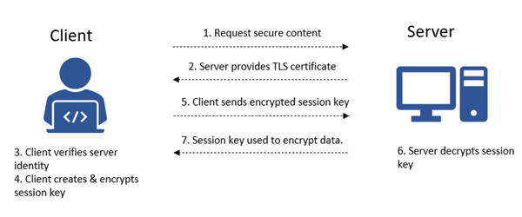
TLS Process Overview

